Slide 1
Functional JavaScript
Avag Arakelyan @Synergy

Slide 2
Contents
Declarative vs Imperative Styles
Loops
`reduce` method, `map` method
Currying
Composition
Type Classes
Functors

Slide 3
Javascript Specs and Features

Slide 4
Cool features of ES6
I was waiting for

Slide 5
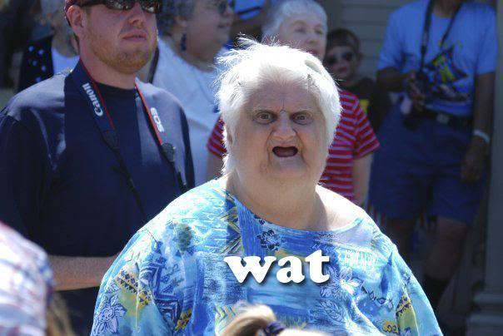
Freaky features of ES6

Slide 6
Declarative Style
Data Transformation
Expressions
Decomposition
Not Verbose/Redundant
Predictible ( Pure Functions )
etc ...

Slide 7
Declarative Style Samples
SQL
Linq
HTML Templating
etc ...

Slide 8
Example of Imperative Style

Slide 9


Slide 10
Imperative Programming
OOP
Procedural Programming

Slide 11
ES5.1 Array Methods
to “stop attack” on our brain

Slide 12
Why `map` is special?

Slide 13
Modification of Examples

Slide 14

Almost there

Slide 15
Currying

Slide 16
Composition

Slide 17
Functional Version of Example

Slide 18


Slide 19
Type Classes
A typeclass is a sort of interface that defines some behavior
Values
Operations
Laws

Slide 20
Type Class Examples
Setoid ( equality )
Semigroup ( concatination )
Monoid ( combination )
Monad ( chaining computations )
etc ...

Slide 21
The world is not perfect

Slide 22
Functors
Type that implements Functor logic,
can be mapped over

Slide 23
Functors
Abstraction of 'map' functonality:
map(f, [1]) => [ f(1) ] => Array( f(1) )
map(f, MyType(1)) => MyType(f(1))

Slide 24
Maybe Functor
if( x != null ){
f(x)
}

Slide 25
Functors
function fmap(mapper, mappable){
return mappable.map(mapper);
}

Slide 26
Maybe Functor
function Maybe(val){
this.val = val;
}
Maybe.prototype.map = function(mapper){
return this.val ? Maybe( mapper(this.val) ) : Maybe(null);
};

Slide 27
Either Functor
if( x != null ){
f(x)
}else{
f(someOtherValue)
}

Slide 28
Either Functor
var Either = function(left,right){
this.left = left;
this.right = right;
});
Either.prototype.map = function(mapper){
return this.right ?
Either( this.left, mapper(this.right) ) :
Either( mapper(this.left), null );
};

Slide 29
Summary
Declarative vs Imperative Styles
Loops
`reduce` method, `map` method
Currying
Composition
Type Classes
Functors

Slide 30
Lets make your code expressive

Slide 31
Thank you

